Slide 1





Integrated Cancer Care System

Slide 2







Problem Statement
Cancer treatment requires coordination across multiple healthcare roles.
Managing vast amounts of sensitive data is challenging.
Lack of a centralized system leads to delays and errors.
Timely communication is essential for better treatment outcomes.
Robust data privacy is needed to protect patient information.

Slide 3




Project Objectives
Develop a multi-role network system for oncology treatment.
Provide role-specific workflows (Doctor, Nurse, Pharmacist, etc.).
Enable secure data storage using SQLite.
Simplify insurance claim processing and medical administration.
Enhance transparency and collaboration across networks.

Slide 4






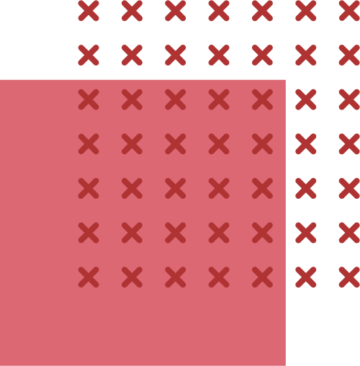
Enterprises
Administration
Pharmacy
Insurance Company
Health Center

Slide 5




Roles
Administrator
Administration Secretary
Administration Treasurer
Administration Health Officer
Oncologist
Radiologist
Lab Assistant

Slide 6
Roles
Nurse
Pharmacist
Patient
Insurance Agent
Insurance Policy Planner
Insurance Finance Manager
Receptionist

Slide 7
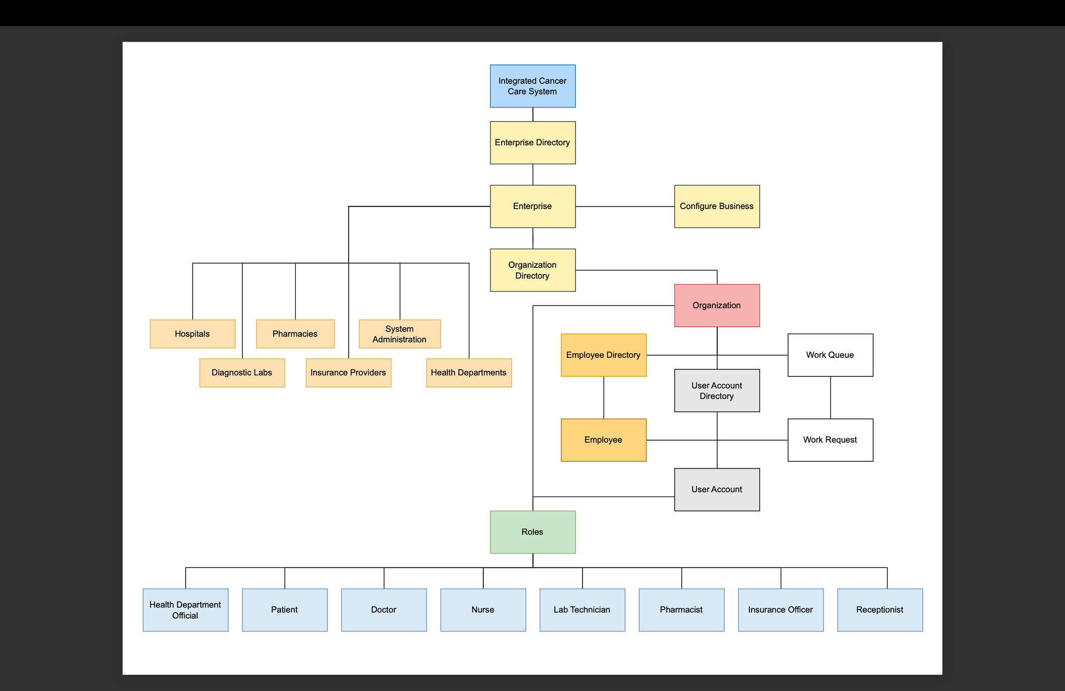
Uml Class Diagram

Slide 8
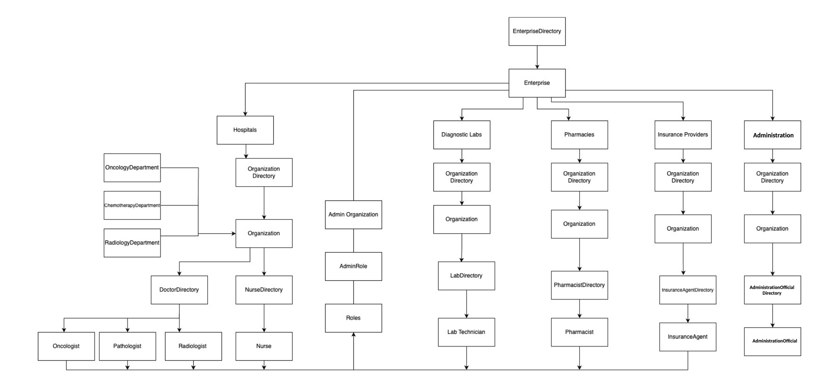
High Level Component Diagram

Slide 9


Advanced Features
Modular ecosystem structure with hierarchical control.
Role-based access and authentication.
Secure patient record handling using SQLite.
Expandable architecture supporting multiple networks.
Support for claim processing and auditing.

Slide 10


Thankyou!
Aaryak Pawar
Chandra Shekar Reddy
Hrishi Pal

